Slide 1
NORABEL HEALTHCARE ANALYSIS SUMMARY REPORT
AYOOLUWA OYEBISI
APRIL,2022

Slide 2
BUSINESS GOAL
Norabel health care is a non-governmental organization that provides essential information on health care. Recent studies shows that there is an increase in the number of heart disease &Hypertension disease which requires extensive analysis. An exploratory analysis using Healthcare patient's datasets to develop an interactive dashboard that provides insights on the key influencing factors on heart disease and hypertensive which will help in making informed decisions.

Slide 3
DATA SELECTION
Identified key data sources and databases for the analysis.
Electronic Medical Record
EXCEL
MEDPAR

Slide 4
APPROACH
In this analysis I used various analytics tools (excel and Power BI to transform, analyze, visualize and create a compelling data story. In this analysis, I;
Explored Health care dataset through various statistical and visualization techniques
Find out demographic factors on both diseases.
Find out behavioral factors on both diseases.
Provided key level insights
Make recommendations that will help to decrease the prevalence of the disease.

Slide 5
ANALYTICS FRAMEWORK
Our AI-powered data analytics framework
Data Selection
Data Exploration
Distribution Analysis
Insights, Conclusion and Recommendations

Slide 6
SUMMARY OF ANALYSIS

Slide 7
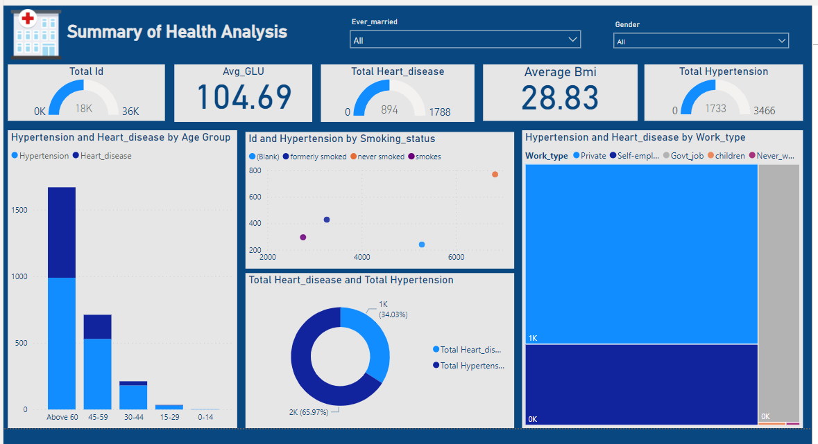
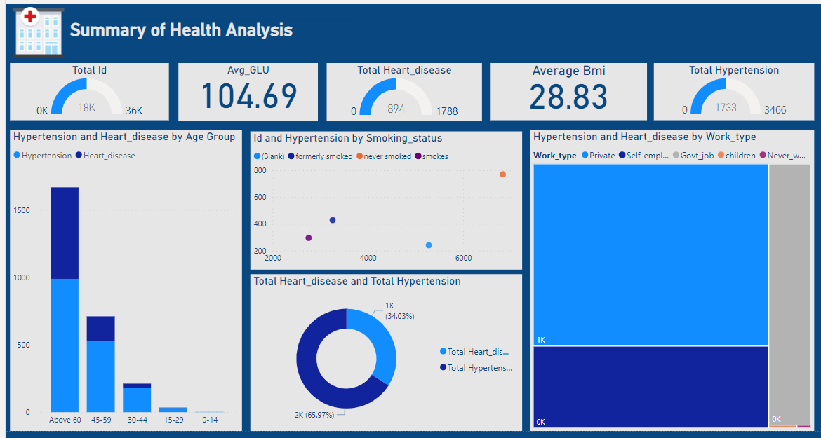
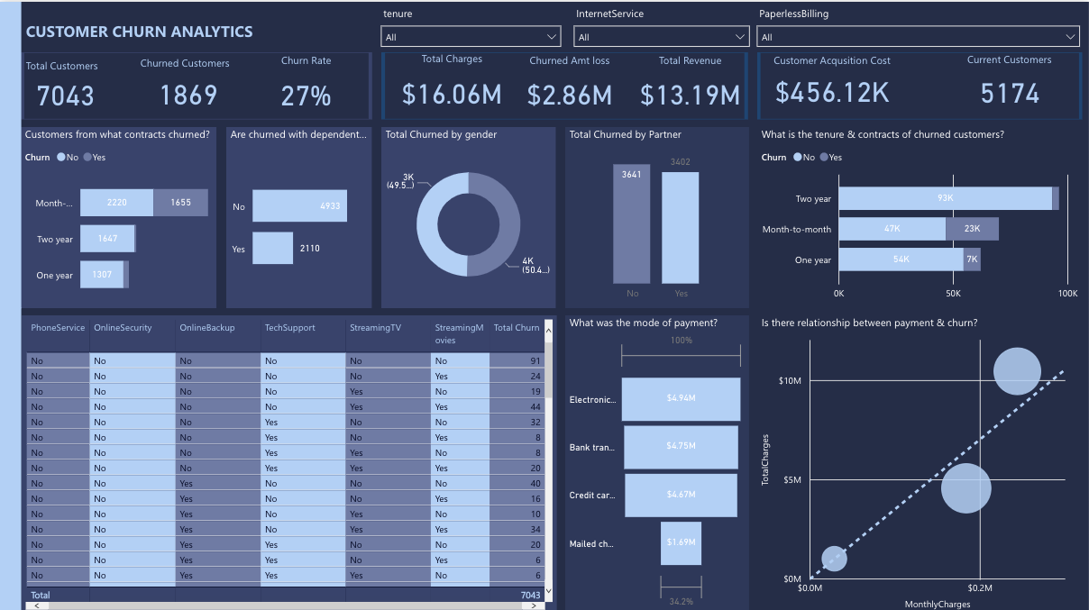

Slide 8
KEY INSIGHTS
I performed univariate analysis against various variables of interest, like;
the impact of demographic factors on both diseases.
the impact of behavioral factors on both diseases.
I derived key valuable insights, identify trends and patterns that can help provide actionable decision making towards reducing Heart and Hypentensive Diseases.

Slide 9
Demographic factors on both diseases

Slide 10
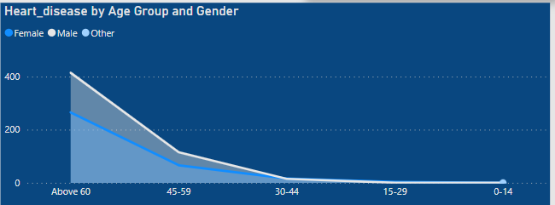
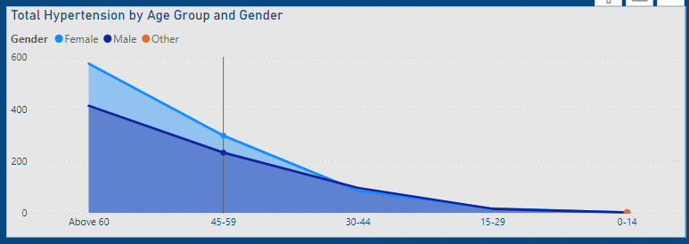
IMPACT OF AGE & GENDER ON BOTH DISEASES

Slide 11
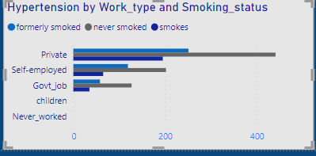
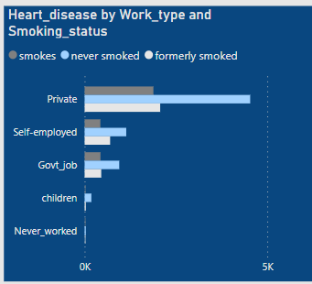
IMPACT OF WORK_TYPE & SMOKING_STATUS ON BOTH DISEASES

Slide 12
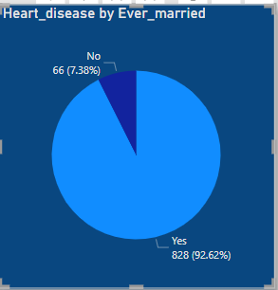
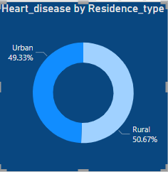
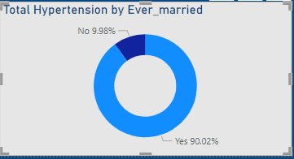
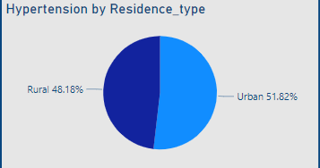
IMPACT OF RESIDENCE_TYPE & MARITAL_STATUS ON BOTH DISEASES

Slide 13
Behavioral factors on both diseases

Slide 14
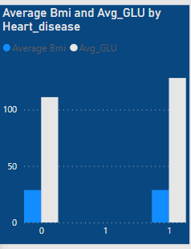
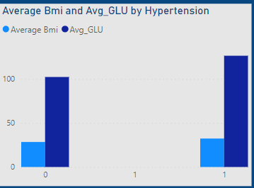
IMPACT OF Avg Bmi & Avg_Glu ON BOTH DISEASES

Slide 15
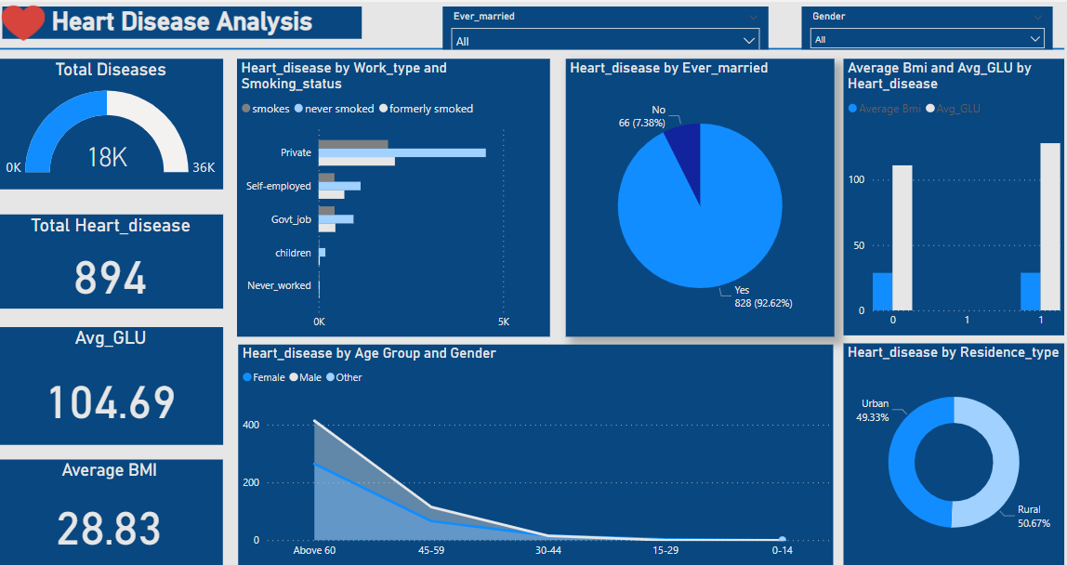

Slide 16
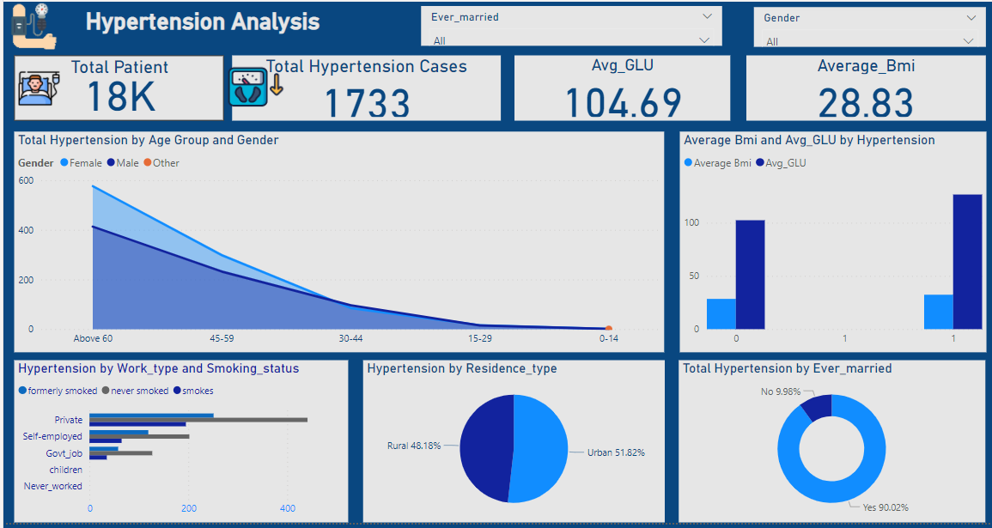

Slide 17
Analysis
Findings
In this analysis, a lot of valuable insights were discovered, trends and patterns were also identified in the dataset. The insights will be listed below:
The number of Heart disease and Hypertension increases as age increases, and the % of female with hypertension is higher than % of male while the % of male with heart disease is higher than the % of female .
Individuals working in a private organization and has never smoked has higher numbers of Heart disease and Hypertension.
92.96% and 90.02% of Ever married individuals has Heart disease and Hypertension respectively.
Residence type has less effect on both Heart disease and Hypertension.
Comparing Average Bmi and Avg Glu on both diseases, Average Glu has more influence on both Hypertensive and Heart disease than Average Bmi.

Slide 18
Further Analysis based on key insights
Based on the variouis analysis done in previous section several deeper questions are asked to strengthen our standing.
Why is Hypertension disease more among female genders?
Why is Heart disease and Hypertension increasing as age increases ?
Why is Heart Disease and Hypertension more predominant in people that has never smoked?
Why is Heart Disease and Hypertension more prevalent in individuals with high Avg glucose ?
To further explore my analysis, an interactive dashboard solution to identify key influencing factors affecting Heart Disease and Hypertension was provided.

Slide 19
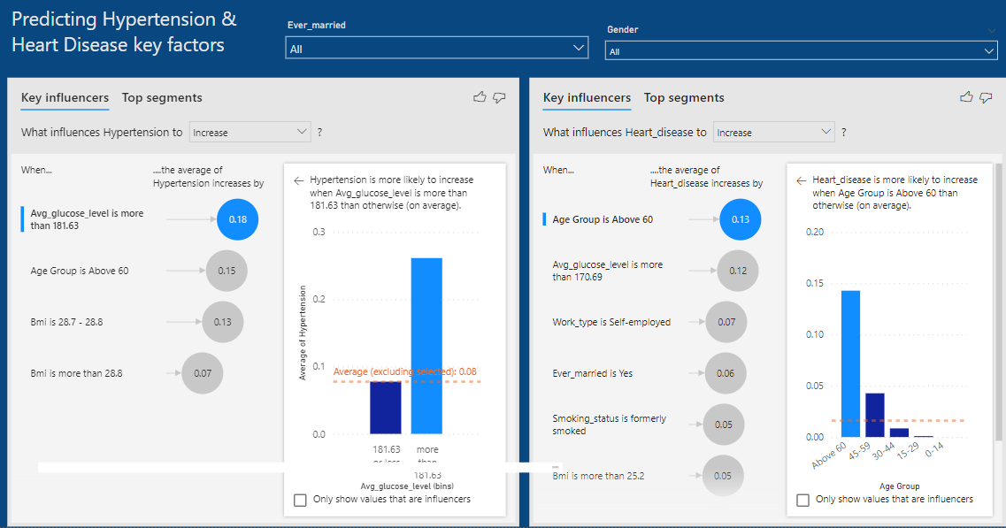

Slide 20
RECOMMENDATIONS
High Priority
Increase in awareness of Heart diseases and Hypertension. Early detection saves live.
High Priority
Eating a healthy diet and Staying at a healthy weight will help reduce both diseases.
Mid Priority
Stress management and regular health screening will help to reduce Heart Disease and Hypertension.

Slide 21
